Slide 1

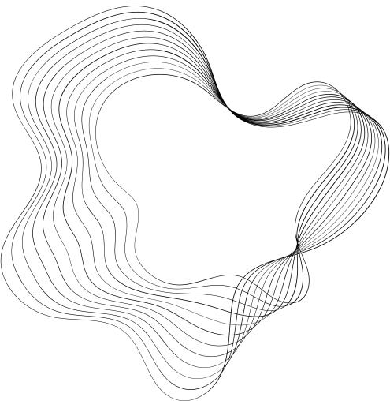
CREDIT CARD MANAGEMENT
BY - ARYAN SINGHAL
Streamlining Credit Card Operations

Slide 2

CONTENT
01
INTRODUCTION
02
KEY FEATURES AND TECHNOLOGIES
03
BACK END DESIGN
04
FRONT END DESIGN
05
CONNECTIVITY
06
FUNCTIONALITY
07
APPLICATION
08
CONCLUSION

Slide 3
INTRODUCTION
The Credit Card Management System is a sophisticated software application designed to streamline the management of credit card data.
Developed using Python and Tkinter for the front-end interface, and SQLite for backend database management.
Focuses on security, usability, and scalability to ensure efficient handling of credit card information.
Aims to provide users with a seamless experience in managing their financial transactions.

Slide 4
User authentication and authorization
Creation and management of credit card accounts
Setting and updating credit limits
Application processing for new credit cards
View and search functionality for stored data
KEY FEATURES
Tkinter: A Python library for creating graphical user interfaces (GUI)
Python: A programming language used for backend logic and application development
SQLite: A lightweight relational database management system used for storing and managing data within the application
Technologies Used

Slide 5
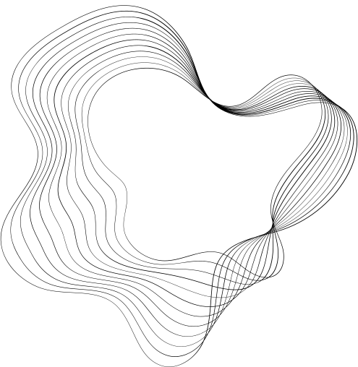
BACK END DESIGN
Schema
SQL Queries
1. Database Schema: Defines the structure of the database tables and the relationships between them. In this project, tables such as USER1, CREDIT_CARD, LIMITS, APPLICATIONS, etc., are defined with appropriate columns and constraints.
2. SQL Queries: The back end handles SQL queries to perform CRUD operations
(Create, Read, Update, Delete) on the database. For example, INSERT, SELECT,
UPDATE, DELETE queries are used to manage user accounts, credit card
information, limits, applications, etc

Slide 6
FRONT END DESIGN
1. Window Layout: Defines the layout and appearance of windows and widgets such
as labels, buttons, entry fields, etc. Different windows are created for tasks like login,
creating a new account, main menu, etc.
2. User Input Handling: Captures user input from widgets and validates it before
sending requests to the back end. For example, when a user enters their login
credentials, the front end validates the input before sending a request to the back end
for authentication.

Slide 7

CONNECTIVITY
Front-End Actions Trigger Back-End Processes: User actions such as clicking a
button or entering data trigger corresponding processes in the back end. For example,
when a user clicks the "Create Account" button, it triggers the back end to insert the
new account information into the database.
Back-End Responses Update Front-End Display: After processing requests, the
back end sends responses to update the front-end display. For example, if a user's
login credentials are valid, the back end sends a response to the front end to open the
main menu window.

Slide 8

Functionality
Insert Data:
Add new records to the database.
Update Data: Modify existing records.
Delete Data: Remove records from the database.
Retrieve Data: Fetch specific records.
View All Data: Display all records.

Slide 9
APPLICATIONS
User Convenience: Provides users with a centralized platform for managing credit card information, enhancing accessibility and convenience.
Data Integrity: Ensures secure storage and management of user data in a centralized database, minimizing the risk of data loss or unauthorized access.
User-Friendly Interface: Designed with a user-friendly interface using Tkinter, making navigation intuitive for users of all skill levels.
Efficient Management: Streamlines credit card management processes by allowing users to create new cards, set limits, and view applications, improving overall efficiency.
Error Reduction: Incorporates error handling mechanisms to minimize errors and ensure a smooth user experience.
User Authentication: Implements robust user authentication mechanisms to safeguard user accounts and prevent unauthorized access.

Slide 10
CONCLUSION
Tkinter and Python were ideal for crafting our credit card management system's GUI. Python's simplicity and Tkinter's rich widget set streamlined development, ensuring an intuitive user interface. Their seamless integration facilitated efficient communication between backend logic and frontend elements, resulting in a cohesive and user-friendly application.

